Slide 1
Public Information Meeting City of Madison Engineering Division [Date] Thank you for attending. We will begin shortly…
Title
Title

Slide 2
Meeting Technical Housekeeping
This meeting will be recorded and posted to the project page.
All attendees should be muted to keep background noise to a minimum.
Use the “Q and A” button for technical issues with meeting to troubleshoot with staff to assist.
Use the “Q and A” button to type questions about presentation. Questions will be answered live after the presentation.
Inappropriate questions may be dismissed.
Use the “raise your hand” button to verbally ask your question. You will be prompted to unmute when it is your turn.

Slide 3
This meeting is being recorded.
It is a public record subject to disclosure.
By continuing to be in the meeting, you are consenting to being recorded and consenting to this record being released to public record requestors.

Slide 4
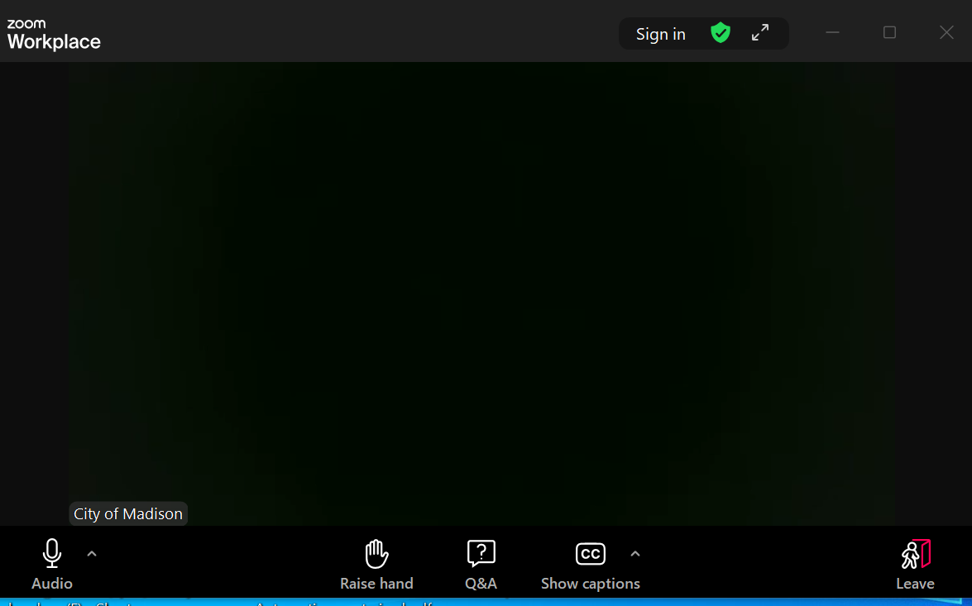
How to Participate
Make sure to
join audio

Slide 5
How to Participate
Raise your hand to be unmuted
For comments or ask additional questions.

Slide 6
How to Participate
Use Q&A button if you have technical issues
or a question for the panelists.

Slide 7
How to Participate
Use Q&A button for all other questions.
We will answer after the presentation.

Slide 8
How to Participate
To leave the meeting, click leave.

Slide 9
How to Participate
If you’d like to enable closed captioning, click “show closed captions” button on the bottom of the screen.
This may already be enabled. If this is not enabled, click the button to allow closed captioning.

Slide 10
Project Contact Introductions
PM Information
City Staff Information
Alder Information

Slide 11
Project Location

Slide 12
Existing Conditions
Item | Existing Condition
Last Surfaced
Pavement Surface Evaluation & Rating
Curb Rating
Width
Surface
Sidewalk
Sanitary
Water
Storm

Slide 13
Proposed Design

Slide 14
Public Right-Of-Way

Slide 15
Construction & Access

Slide 16
City & County Funding

Slide 17
Assessment Policy & Costs

Slide 18
Project Schedule
Date: Advertise for Bids
Date: Mail Estimated Assessments, Public Hearing Notice
Date: BPW Public Hearing
Date: Common Council Hearing
Date: Begin Construction
Date: End Construction

Slide 19
Contact Information & Resources
Engineering
Title, Name, Phone, Email
Title, Name, Phone, Email
Title, Name, Phone, Email
Project Website: cityofmadison.com/engineering/projects/?????
Sign-up for project email updates on the website
Updates on closures & work progress will be posted to the project website
Recording of this presentation will be posted on the project website
Facebook – City of Madison Engineering
Instagram – @MadisonEngr
X – @MadisonEngr
Podcast: Search Everyday Engineering on Apple iTunes or your podcast provider

